Slide 1
PowerShell for the Reluctant Administrator
I won’t be at all offended if you decide that this session isn’t for you.
If you do leave, please try not to disturb others, and send Pat@YetAnotherSQL.com an email and tell me how I can improve the abstract so that future attendees can make better choices!

Slide 2
Event Information
Thank you Sponsors!
Please visit the sponsors during the vendor break from 2:45 – 3:15 and enter their end-of-day raffles
Event After Party
Dave and Buster’s in Southdale Center. 3rd floor by Macy’s starting at 6:15
Want More Free Training?
PassMN meets the 3rd Tuesday of every month. https://mnssug.org/
MN Microsoft BI User Group – meets quarterly http://www.microsoftbiusergroupmn.org

Slide 3
PowerShell for the Reluctant Administrator
An introduction to PowerShell for the Administrator who doesn’t understand why everyone seems excited about PowerShell.

Slide 4
Confessions
I’m script-centric, I prefer PowerShell and Transact-SQL to GUI based tools.
I use Wikipedia.
It helps more people than English-Only sites.
It is built and maintained collaboratively often by people doing new research, so it has articles months or years ahead of others.

Slide 5
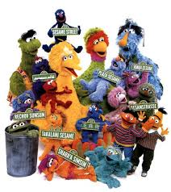
Sesame Street style PowerShell Presentation
The intended audience is the programmer or the dedicated scripter, not the Administrator
The primary purpose of this type of presentation is to teach you HOW to create a PowerShell script.
The focus is on creating PowerShell code.
The emphasis is on using the ISE (Integrated Scripting Environment).

Slide 6
Sesame Street style PowerShell Presentation
The intended audience is the programmer or the dedicated scripter, not the Administrator
The primary purpose of this type of presentation is to teach you HOW to create a PowerShell script.
The focus is on creating PowerShell code.
The emphasis is on using the ISE (Integrated Scripting Environment).

Slide 7

Reading Rainbow style PowerShell Presentation
The intended audience is the somewhat jaded Administrator who is really looking to make their job easier, and maybe for the other folks (programmers, dedicated scripters, Quality Assurance team, etc.) who want things to be safe, testable, and repeatable on demand.
The primary purpose of this presentation is to teach you WHY you want to use PowerShell.
The focus is on using code to make your life simpler, easier, faster, etc.
The emphasis is getting work done, and we like easy but aren’t picky about the tools used to accomplish that goal.

Slide 8
First, the boring fundamentals
How has PowerShell evolved
What is a shell
What are examples of what a shell can do
Important geeky stuff in PowerShell

Slide 9
PowerShell Versions
YYYY-MM | Version | Important New Features
2003-09 | 0.1 | “Monad” pre-release at LA MS Prof Dev Conference
2006-11 | 1.0 | PowerShell RTW (Release to Web)
2009-11 | 2.0 | ISE, Modules, PS Remoting, PS Jobs, Script Cmdlets (modules no longer required .NET)
2012-09 | 3.0 | Automatic module detection, scheduled jobs, Intelisense, updatable help, huge cmdlet library
2013-10 | 4.0 | DSC, enhanced debugging, Windows Servers get default RemoteSigned execution policy!
2014-04 | 5.0 | Public preview, not production as of 2015-08-01 Can create classes in PowerShell! OneGet (apt-get for Windows), better handling of Layer 2 switches

Slide 10
Windows Common Engineering Criteria
SharePoint
Exchange
SQL Server
BizTalk
Dynamics
Systems Center
Hyper-V
Lync

Slide 11
What is a Shell - Examples
Unix shell
REXX
TSO
MS-DOS Shell
Windows Shell
PowerShell
Pash – Open Source PowerShell work-alike

Slide 12
Shell - Definition
Command interpreter
https://en.wikipedia.org/wiki/Shell_(computing)
Three flavors
Script/text (like bash, Korn, cmd.exe, command.com)
GUI (Graphic User Interface, such as Windows)
Menu (attributes of both script and GUI but simpler, like the UCSD p-System)
This is how the user tells the computer what they want the computer to do.

Slide 13
Partial list of Windows tools that PowerShell can directly access
AD (Active Directory)
WMI (Windows Management Instrumentation)
COM (Component Object Model)
CIM (Common Information Model)
ADO (ActiveX Data Objects)

Slide 14
PowerShell geeky stuff
What is a variable?
What can I do with it?
Why do I care?
How do I use it?

Slide 15
More PowerShell geeky stuff
What is a PowerShell pipeline?
When should I use a pipeline?
How can a pipeline help me?

Slide 16
Even more geeky PowerShell stuff
What if PowerShell isn’t enough for a job I want to accomplish, how can I get even more?
What changes will come soon that could affect my PowerShell scripts?

Slide 17
Demos

Slide 18
How To
Internet “places” to find help for Administrators who want to USE PowerShell, not write scripts for a living.
http://powershell.sqlpass.org/
http://www.PowerShell.com
http://blogs.technet.com/b/heyscriptingguy/

Slide 19
Even More Confessions
I NEED feedback!
Please comment on everything: good, bad, or noteworthy! I want to improve.

Slide 20
Evaluations
Remember to fill out your online evaluations for the event and any sessions you have attended. They will be online until 10/17/15.
http://www.sqlsaturday.com/453/eventeval.aspx
http://www.sqlsaturday.com/453/sessions/sessionevaluation.aspx

Slide 21
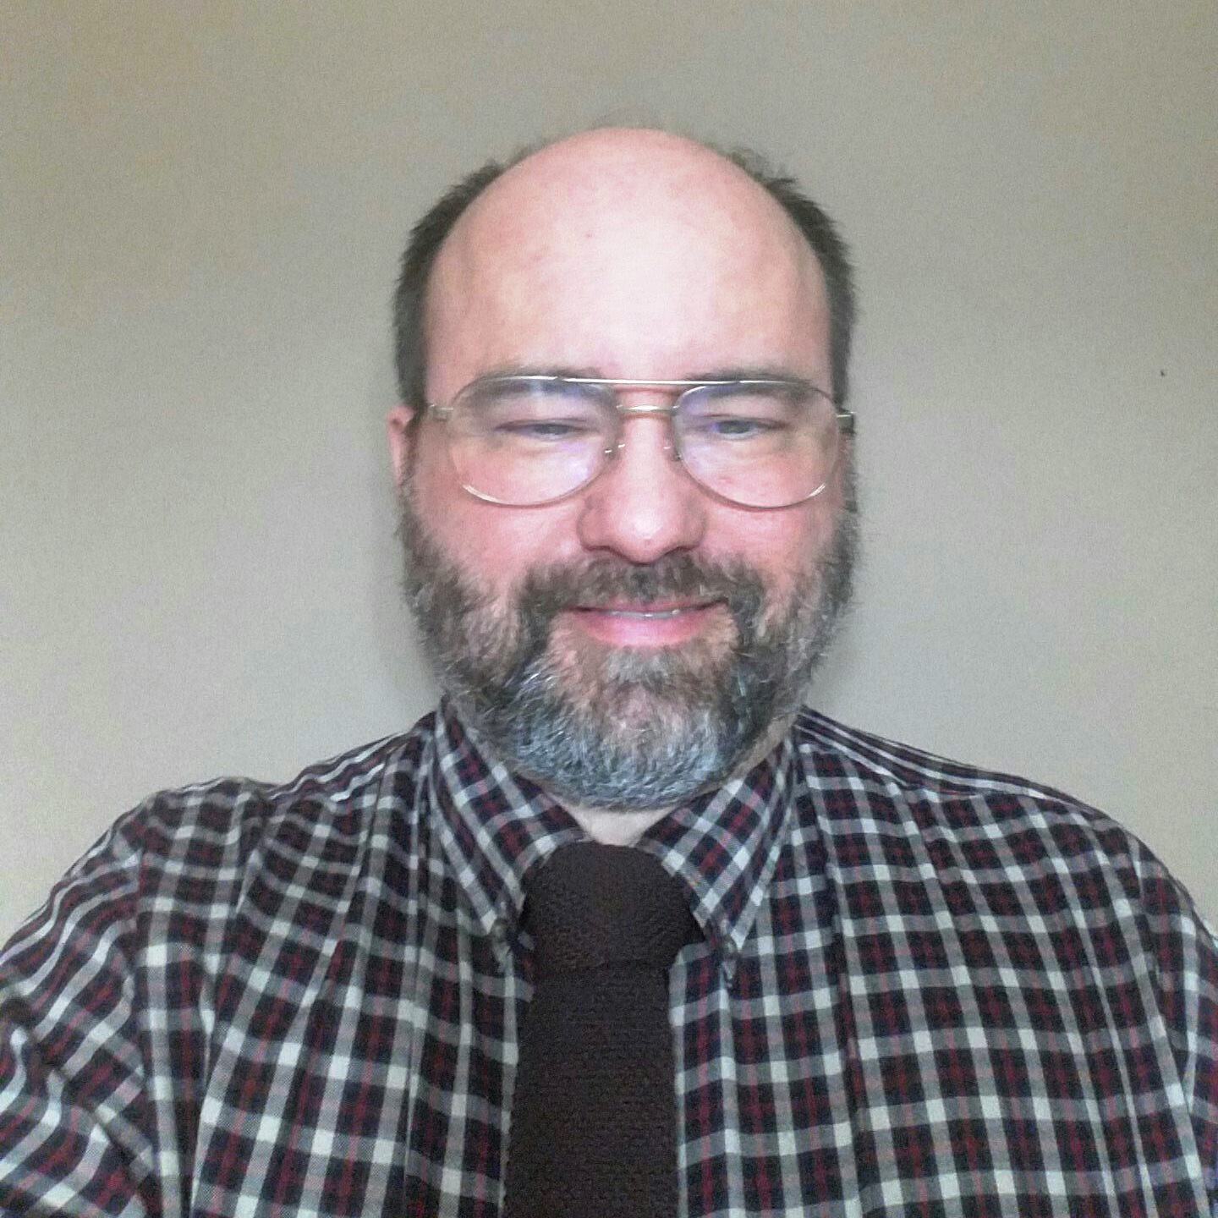

Pat Phelan PowerShell for the Reluctant Administrator
Pat is a Database Engineer at Involta, LLC.
Email:
Pat@YetAnotherSQL.com
Twitter:
@YetAnotherSQL

